Slide 1
MASTER THESIS BY SAFIN & TEJU
Department of Computer Science,
University of Stavanger

Slide 2

STABLE DIFFUSION AND IMAGE GENERATION WITH COMFYUI TO ASSIST DESIGNERS
CASE STUDY OF LAERDAL MEDICAL

Slide 3
PROBLEM STATEMENT
Inability to generate a fast and consistent Laerdal-style illustrations.
Inconsistent output quality
Limited customization
Difficulty in integrating AI tools into existing design
workflows.

Slide 4
goalS & OBJECTIVES
Generate consistent Laerdal-style images using Stable Diffusion.
Fine-tune with LoRA to enhance model adaptation to Laerdal’s style.
Providing illustrators and designers with better control over generated images.

Slide 5
STABLE DIFFUSION
An open- source and customizable generative model
Generates realistic and artistic images
Text – to- image model using latent diffusion

Slide 6
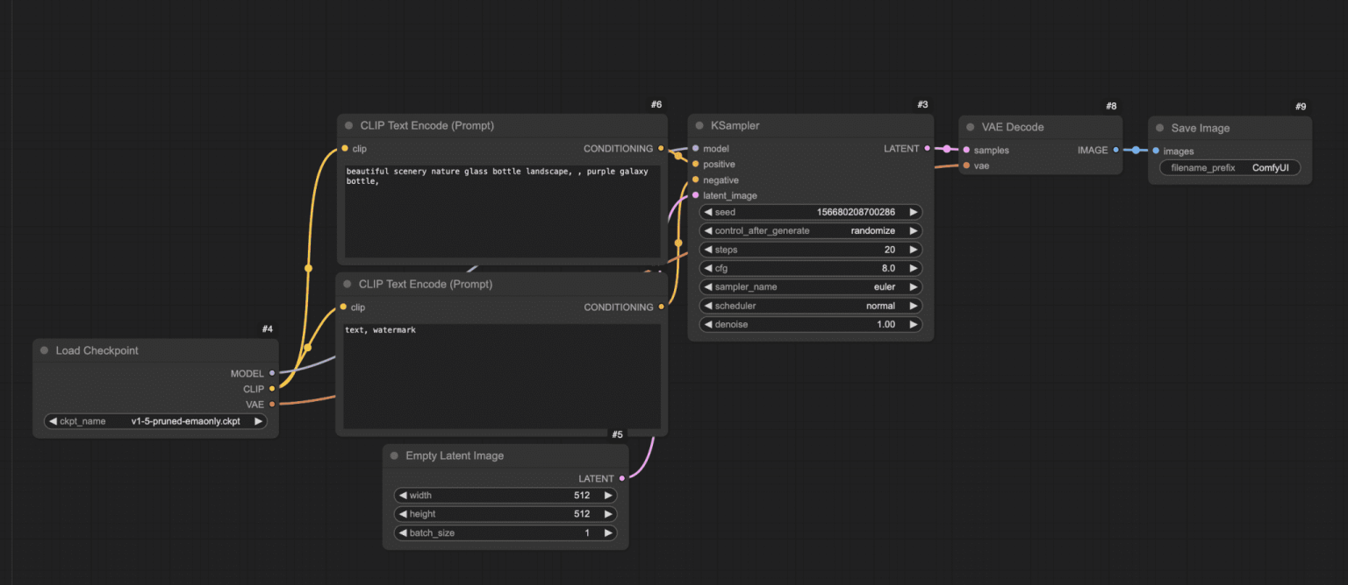
COMFYUI: VISUAL WORKFLOW INTERFACE
A node based interface for stable diffusion
Connecting nodes to define complex pipelines
Flexible user control and reproducibility

Slide 7
ADVANCED TECHNIQUES
LoRA - Low Rank Adaptation
- Efficiently fine tunes large models
- Injects minimal parameters for style learning
ControlNets
- Guides generations using pose, depth, edge maps
- Ensures structures and compositions
Kohya training
-Custom LoRA fine tunning method
-Trains on custom datasets
- Enables prompt alignment.

Slide 8
MODELS COMPARISON
SDXL(v1.5)
SD 3 MEDIUM
DREAMSHAPER
JUGGERNUTS
(Models can be downloaded from civitai and hugging face website)

Slide 9
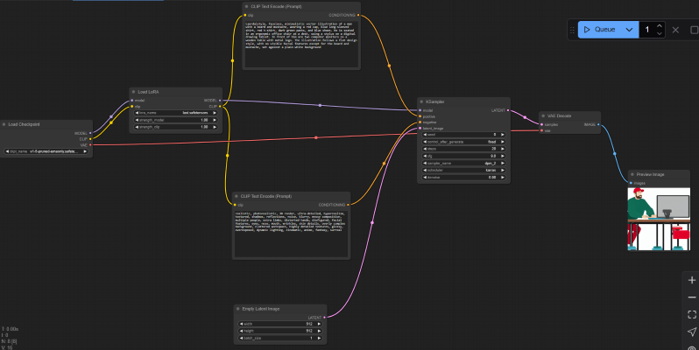
PRACTICAL APPLICATIONS FOR DESIGNERS AT LAERDAL
Text2Image
Image2image
Upscaling
Inpainting
Image2Video
Video2Animation

Slide 10
RESULTS: CONSISTENCY & STYLE
Recreate visuals matching internal design needs
-Higher consistency with base model
Style alignment achieved
Higher productivity

Slide 11
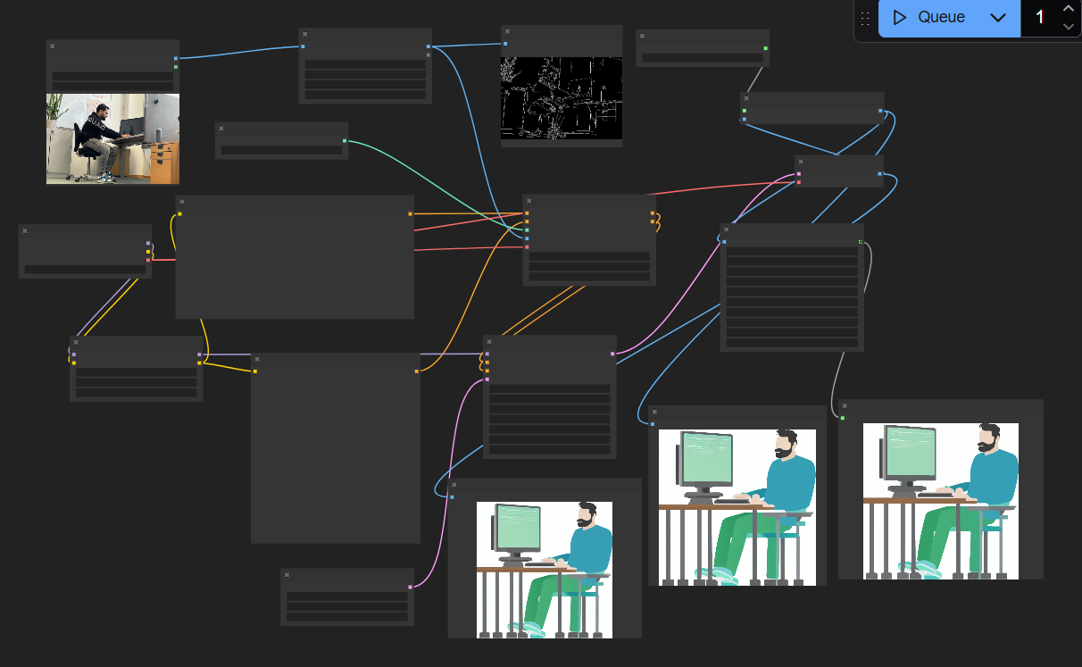
WORKFLOW EXAMPLE: UPSCALING
More detailed svg output!

Slide 12
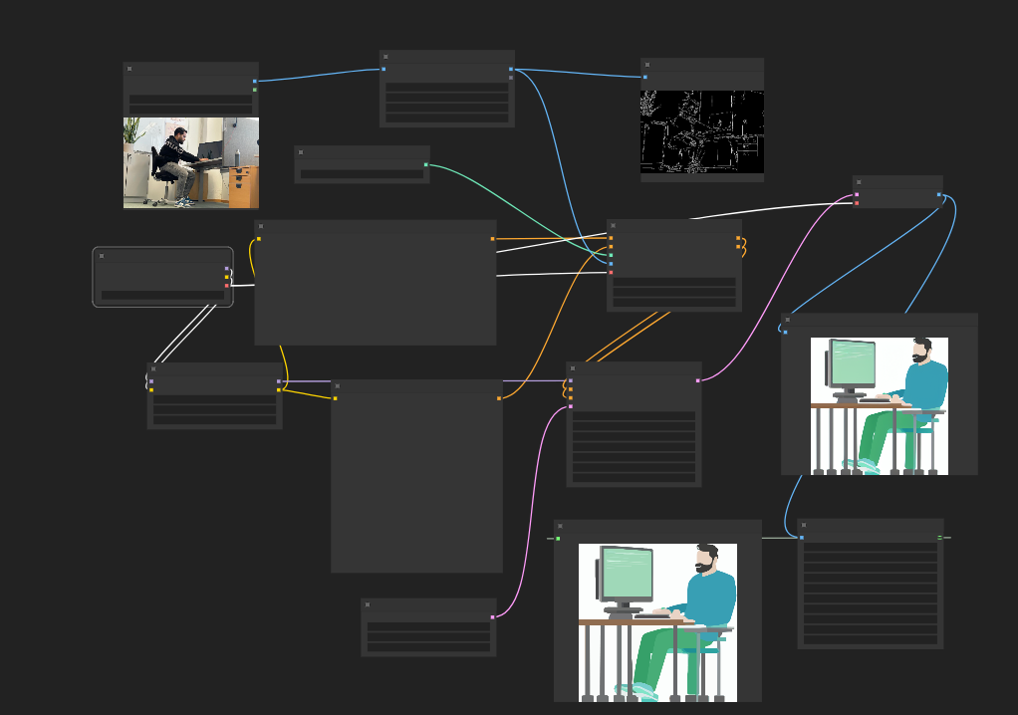
WORKFLOW EXAMPLE: IMG2IMG
From a random image to a Laerdal style image

Slide 13
WORKFLOW EXAMPLE: IMG2VIDEO

Slide 14
WORKFLOW EXAMPLE: VIDEO2ANIMATION

Slide 15
THANK YOU
We’d love to hear your thoughts, feedback and ideas for improvements!”
?

